Slide 1
DSC 640 Presentation: Flying with Southwest
Shu Liu

Slide 2
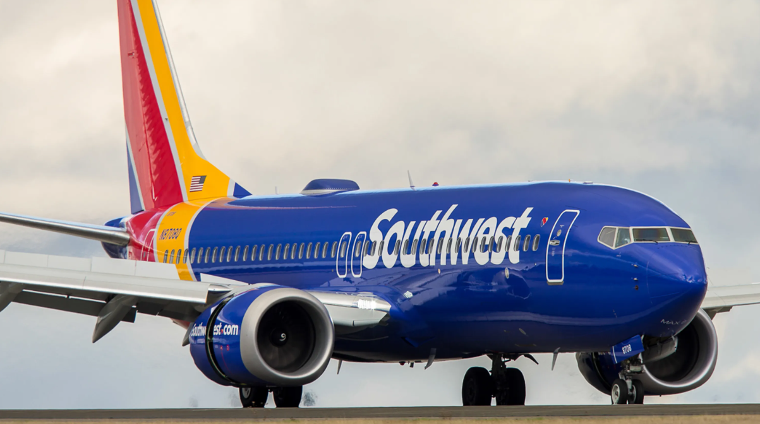

Flying with Southwest…
…is still the safest way to go where you need to be.

Slide 3
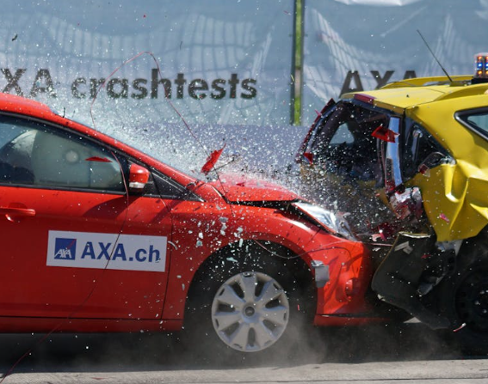
Less Accidents
The number of accidents is much lower in the air.

Slide 4

Less Accidents
The number of accidents is much lower in the air.
More safety features
Air traffic has more technological and safety features than cars.

Slide 5
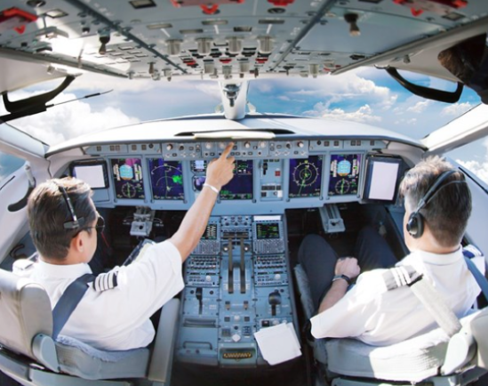
Less Accidents
The number of accidents is much lower in the air.
More safety features
Air traffic has more technological and safety features than cars.
Better training
Pilots are better trained than drivers.

Slide 6

More regulation
Less Accidents
The number of accidents is much lower in the air.
More safety features
Air traffic has more technological and safety features than cars.
Better training
Pilots are better trained than drivers.
Air travel has more checks & balances.
Notes:
FAA (Federal Aviation Administration); NTSB (National Transportation and Safety Board)

Slide 7
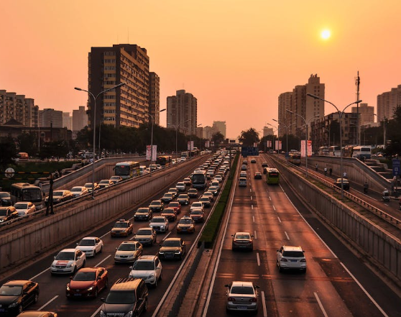
Less traffic
Less Accidents
The number of accidents is much lower in the air.
More safety features
Air traffic has more technological and safety features than cars.
Better training
Pilots are better trained than drivers.
More regulation
Air travel has more checks & balances.
Airspace is much less crowded than public roads.

Slide 8
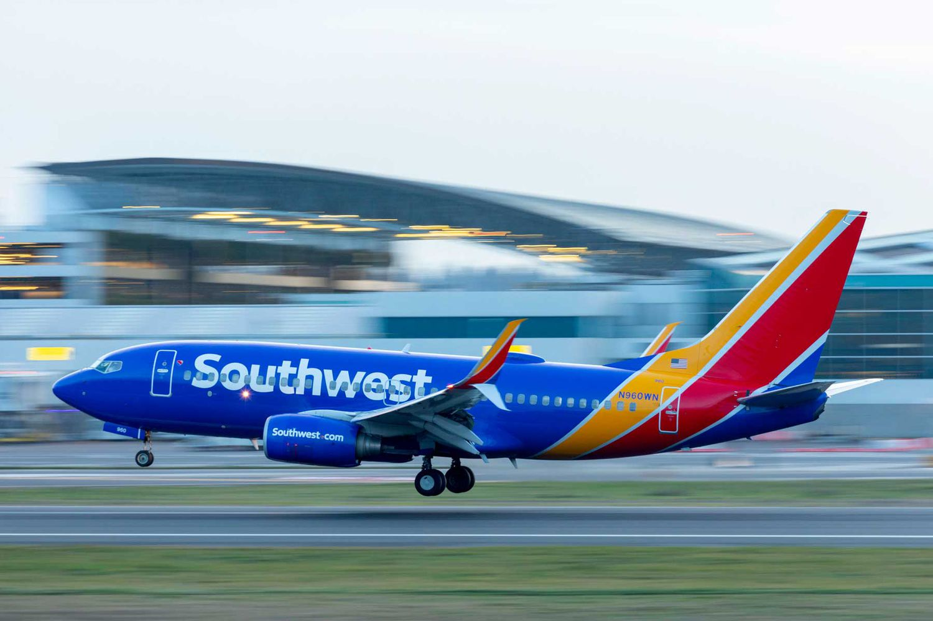
In Short…
…flying is safer than driving, so if you're looking for a safe way to travel, flying is the way to go.
Fly Southwest!

Slide 9
Thank You

